Slide 1


Insightful
Equity
A Stock Market Prediction Platform Using Statistical Analysis and Sentiment Analysis
By – Nikhil Kumar, Mayank Sharma, Ishita Tyagi

Slide 2
CONTENTS
Introduction | Overview of the presentation & Objectives and scope of the analysis
Background | Brief introduction to equity markets & Importance of predictive analytics in finance
Data Collection | Sources of data (financial, sentiment analysis sources) & Challenges and considerations in data collection
Data Preprocessing | Cleaning and preparing financial data & Text preprocessing for sentiment analysis
Statistical and Sentiment Analysis | Exploratory data analysis (EDA) of financial data & Explanation of sentiment analysis in finance
Results and Findings | Insights gained from the analysis, Presentation of predictive results click here
For more info: https://yadavnikhilrao.github.io/portfolio/
You can visit our project: https://insightfulequity.pythonanywhere.com

Slide 3
InsightfulEquity!
InsightfulEquity: Your trusted partner for stock market investments, leveraging predictive analytics and sentiment analysis to provide data-driven insights for informed decisions and a competitive edge in financial markets. Discover the future of investment with us.

Slide 4
INTRODUCTION
In today's dynamic financial landscape, predicting stock market movements and analyzing market sentiment in real-time have become crucial for investors and financial institutions. Accurate forecasts can significantly impact investment strategies, risk management, and decision-making processes.
Accurate prediction models offer valuable insights for investors, aiding in informed decision-making and risk management. They help identify optimal entry and exit points, maximizing returns and minimizing losses. Successful prediction models are essential for gaining a competitive edge in the market.

Slide 5
BACKGROUND
Stock market prediction involves various approaches, including technical analysis methods like moving averages and relative strength index, fundamental analysis utilizing metrics such as earnings per share and price-to-earnings ratio, machine learning models such as regression, decision trees, and neural networks, sentiment analysis based on news and social media, quantitative analysis using statistical methods, time series analysis with techniques like ARIMA and GARCH, and ensemble methods for combining prediction.
Despite efforts to model complex relationships and utilize vast datasets, accurately predicting stock prices remains challenging due to the unpredictable nature of financial markets and the impact of external factors like geopolitical events and economic changes.

Slide 6
TABLE OF STEPS
01
02
03
DATA COLLECTION
DATA PROCESSING
STATISTICAL & SENTIMENT
Efficient data collection for comprehensive market analysis.
Efficient data processing leveraging advanced technologies for insightful analytics.
Advanced statistical and sentiment analysis techniques for enhanced stock market prediction and sentiment-driven insights.

Slide 7
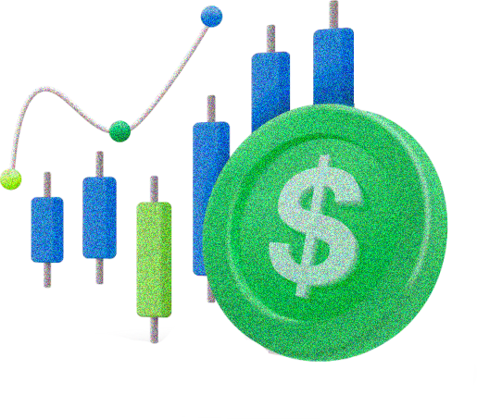
01
DATA COLLECTION
Efficient data collection for comprehensive analysis and insights.

Slide 8

Data Acquisition Strategies for Stock Market Prediction
Data-driven stock prediction with precise data sourcing strategies:
Define Data Requirements
Select Data Sources
Data Cleaning and Preprocessing
Use of Web Scraping Tools
Real-time Data Streaming
API Integration
NLP for Sentiment Analysis
Continuous Monitoring and Updates

Slide 9
02
DATA PROCESSING
Streamlined data processing for efficient analysis and insights.

Slide 10
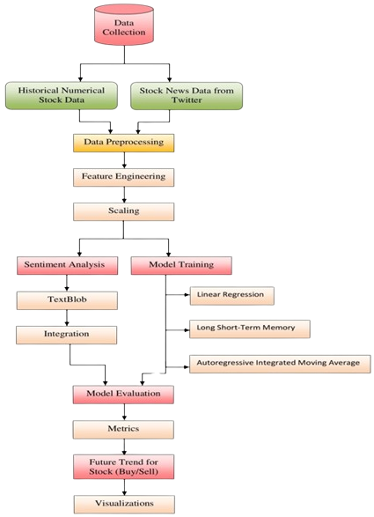
The originality of the raw data is rarely preserved in realworld scenarios, which requires a careful data preprocessing stage to ensure the integrity and quality of our analysis [11]. Address challenges such as missing values by combining forward and backfill strategies to maintain time series continuity. These technologies reduce deficiencies associated with data gaps and ensure seamless time flow.

Slide 11
03
STATISTICAL & SENTIMENT
Merging statistical analysis with sentiment evaluation for informed market insights.

Slide 12
Stock Price Prediction Models:
The Autoregressive Integrated Moving Average (ARIMA) model is essential for time series forecasting, combining autoregressive, integrated, and moving average components to capture trends and address data non-stationarity, crucial for accurate stock price prediction.
Long Short-Term Memory (LSTM) networks excel in modeling complex temporal dependencies in stock price data, utilizing memory cells to understand long-term connections, enhancing forecasting accuracy.
Linear Regression establishes relationships between predictor variables and target variables, revealing connections between financial indicators and historical stock prices with interpretability and simplicity.
Sentiment analysis using the TextBlob library quantifies emotional tones in stock-related tweets, enriching predictive models by integrating emotional trends with historical data for a holistic view of stock market dynamics.

Slide 13

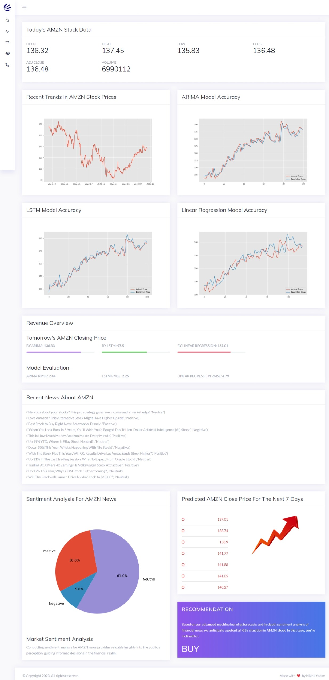

Slide 14

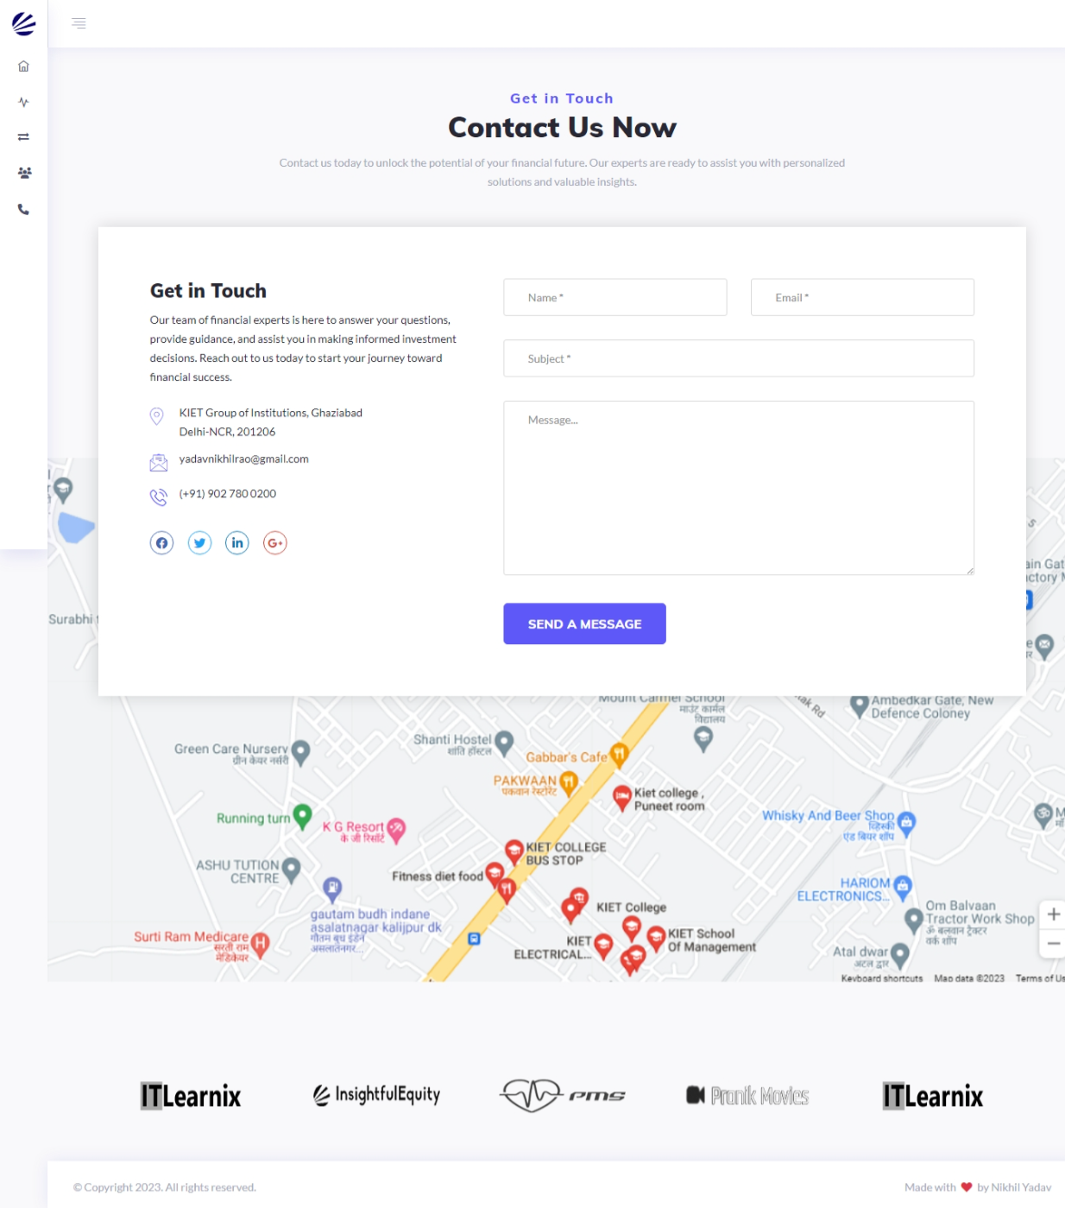

Slide 15
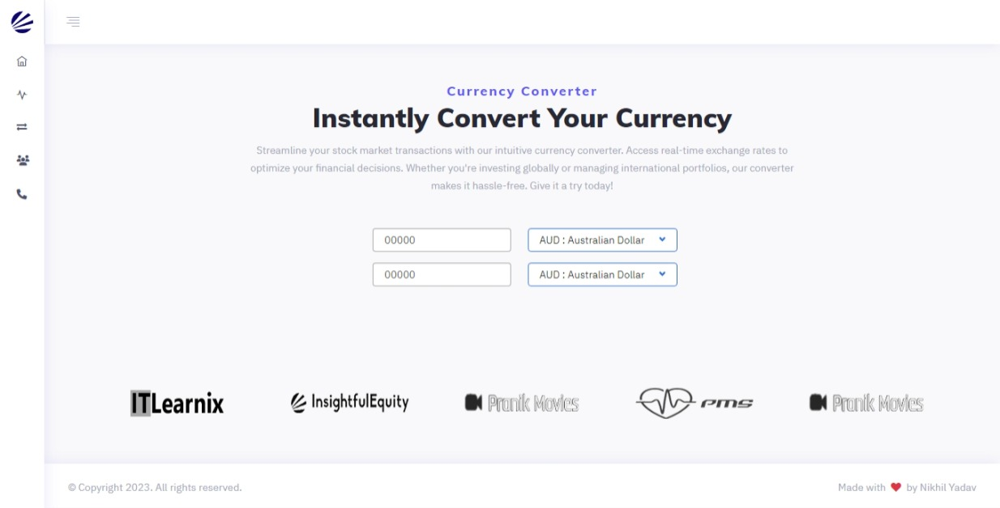

Slide 16


